Slide 1
The Design of SmartPass
By: Lucas Webber

Slide 2
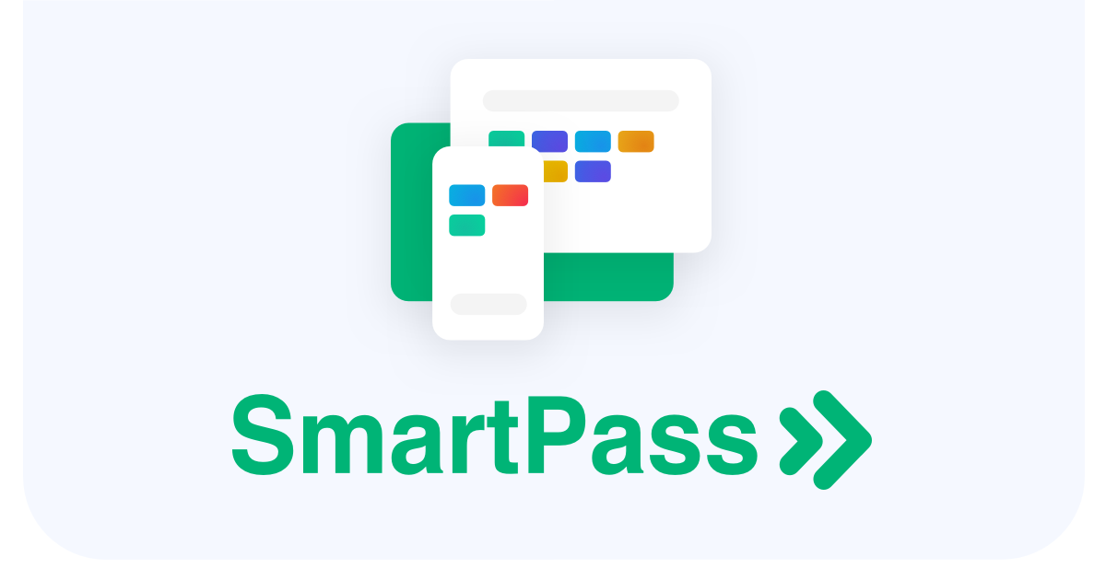
Background Information
What do they do?
They allow schools to monitor who is in the hallways at all times
Allows for different locations
Time Tracking
User Management
Who are they?
45 employees
Founded in 2019
Approximately $4 million in revenue
Notes:
What do they do?
Backup users files
Allow access to files anywhere
Workflow and collaboration manager
File syncing
Who are they?
Founded by MIT students in June 2007
Today they are given a valuation of over US$10 billion
11 million paying customers

Slide 3
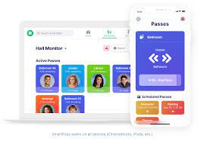
User Base
Targeting small audience
Students
All education levels
Students with computers
Schools
Monitor Student hall activity
Restrict access to out of classroom

Slide 4
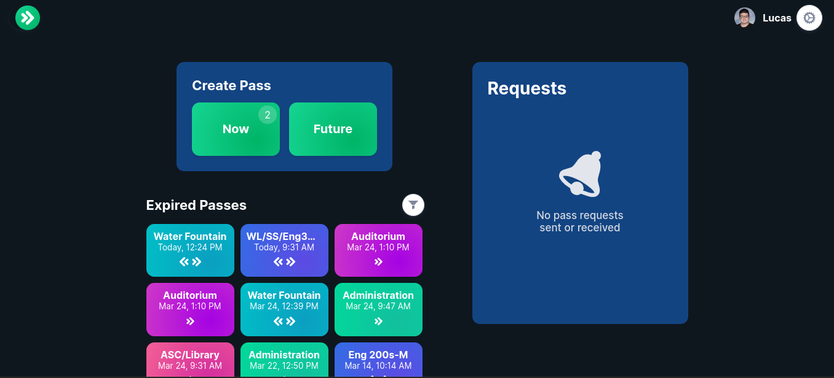
Accessibility Design
Pros
Simple User Interface
Support for Oauth (Clever, etc.)
Dark / Light theme
Cons
Many different colors, can be hard for color blind people
No native color blind support
No native resize text support
No native dyslexia font
All past passes are shown

Slide 5
User Flow

Slide 6
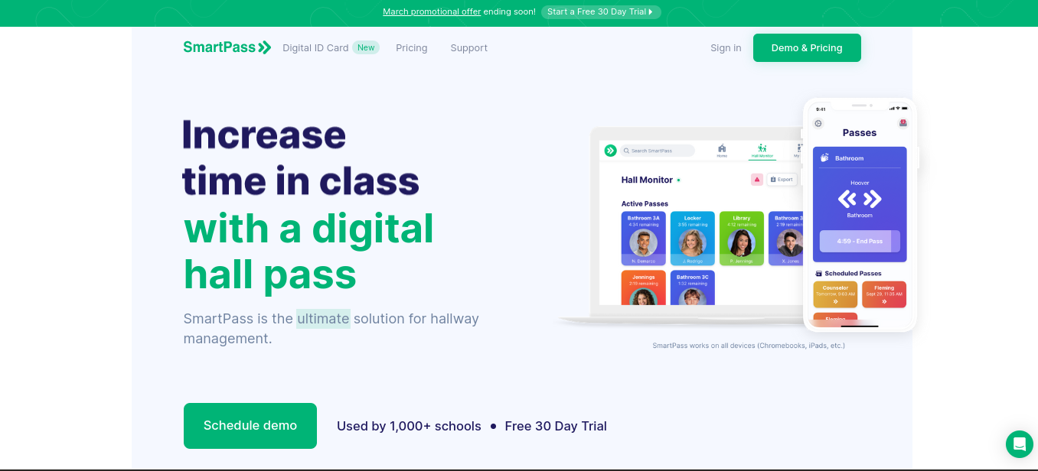
Website Homepage Design
If a user is already logged-in
Forwards directly to pass dashboard
Shows a way to create passes
Shows all old and expired passes
If a user is not logged in
Forwards to a homepage
Provides an overview
Clear footer at bottom of page
Animations to homepage
Explains features of the app

Slide 7
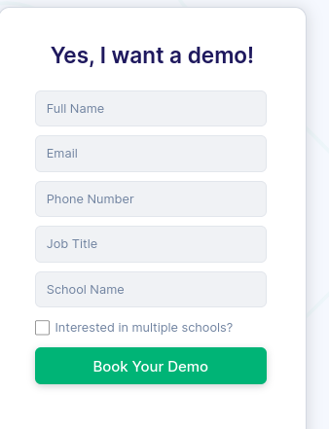
Signup Process
Schools have to sign up
Form allows for a demo before purchasing
Simple Account Creation
Full Name
Email
Phone Number
Password
School
Job Title

Slide 8
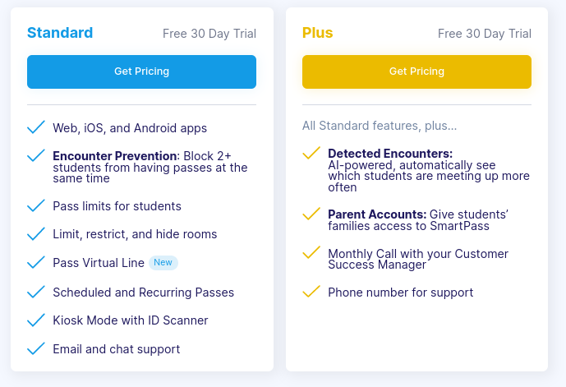
Payment Experience
Tiered subscription model
Standard
Web, IOS, and android apps
Pass Limits
Kiosk Mode
Limit Rooms
Plus
Everything in Standard, Plus
Parents Accounts
Phone and Monthly call support
Additional account services
No Public Pricing Available
Digital ID Addon

Slide 9
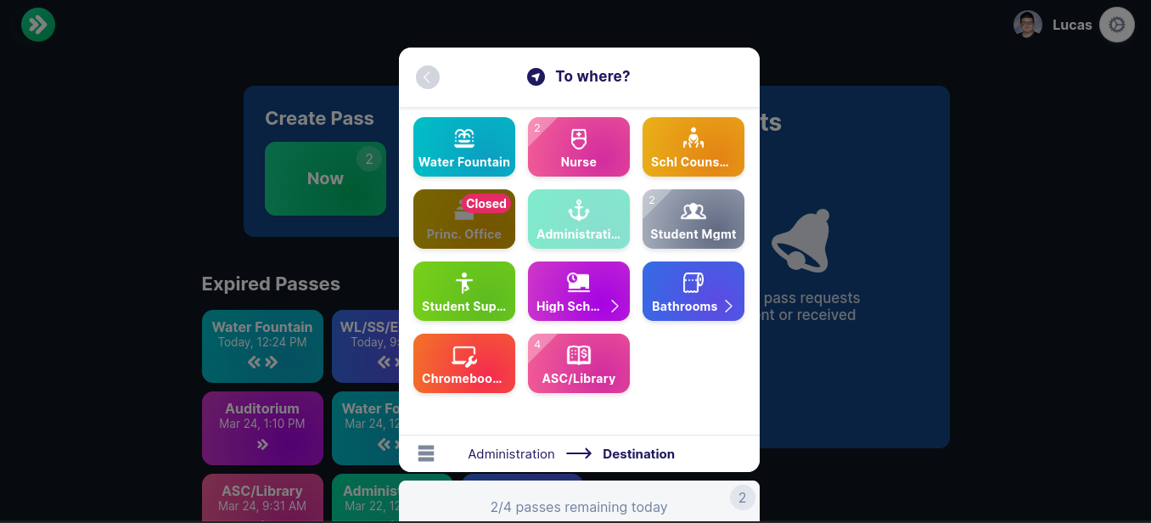
Key Takeaways
Simple to use interface
Minimalist design
Green color throughout
Pricing hidden without request
Supports all sizes of schools

Slide 10
Works Cited
https://www.smartpass.app/pricing
https://www.smartpass.app/
https://www.linkedin.com/company/smartpassco

Slide 11
Thank You

